Slide 1

Date : 17th August 2025
Time : 1100 AM to 1:00 PM
Venue: Star Durbar Balkhu, Kathmandu
19th GENERAL ASSEMBLY MEETING-2081/2082
Participation : Physical

Slide 2
19th General Assembly Meeting
Annual Progress Report -2082
Date : 17th August- 2025
Star Durbar Resort- Kuleshwar, Kathmandu

Slide 3
CONTENTS
VMGOS
Introduction
Project’s Major Achievements
SWOR Analysis
Organization’s Strategy for sustainability
Constraint Challenges
Lesson Learnt

Slide 4
Introduction of Good Neighbours Nepal
Good Neighbors Nepal (GNN), Nepali name Ashal Chhimeki Nepal(ACN) is a non-government organization, established in 2002 at Kathmandu, Nepal with the aim of transforming the community for the sustainable development.
Vision : To see the people’s living in well-developed community through Child Protection, Education, Livelihood Improvement, Health and WASH.
Mission: Transforming the target communities by ensuring an effective child protected community development process.
Goal :
To facilitate the practical solution to uplift the backwardness of society along with facing the social challenges through Education System Improvement.
To transform the community with improved Resilient Livelihood and Nutrition.
To transform the Health, WASH and hygiene behavior of community people.

Slide 5
Introduction of Good Neighbours Nepal
Objectives :
Providing the formal and non-formal education along with skilled training, vocational training, and arts for the needy community for developing the skilled and civilized society for ensuring the child protected self-reliant community.
Conducting the advocacy-related activities along with medical camp and required materials support to health institutions and WASH awareness programs.
Supporting on agriculture, and forestry with the community development approach along with community infra support and relief support in emergency.
Coordinating and collaborating with the national and international like-minded agencies for the achievement of the common goals and objectives.

Slide 6
Governance System (Policies, Guidelines and Procedures formulation
1. Financial and Accounting Policy
2. Procurement Guideline
3. HR Policy
- Progressive Disciplinary Action Procedure
- Health, Safety and Security Procedure
- Employee Service Facility Procedure
4. EC Management Guideline
5. Social Audit Guideline
6. Child and Adult Safeguarding Guideline
7. Administration Management Policy

Slide 7
Governance System ( Policies, Guidelines, Procedures Formulation)
8. Anti - Fraud, Corruption, Bribery and Money Laundering Guideline
9. Whistleblowing Guideline
10. Conflict of Interest Guideline
11. GEDSI Guideline
12. Environment, Social and Governance (ESG) Guideline
13. Internal Control System (ICS) & Risk Management Guideline
14. Data Privacy, Security and Management Guideline
15. Value for Money Guideline
Emergency Financial and Supply Chain Procedure
Monitoring Evaluation Adopting and Learning (MEAL) Guideline

Slide 8
Governance System ( Policies, Guidelines, Procedures Formulation)
18. Fixed Asset Disposal and Management Guideline
19. Disaster Risk Reduction Management and Civil Protection Guideline
20. Downstream Partners Guideline
21. Strategies and Standard Operating Procedure (SOP) Guideline
22. Code of Ethics
23. Communication Policy

Slide 9
Introduction/Background
Good Neighbors Nepal (GNN) is a non-government organization established in 2002, focused on holistic community transformation through interventions in Livelihood, Health, WASH, Education, and other critical issues. The organization's vision aims for well-developed communities through child protection and improved living standards, while its goals emphasize enhancing education, resilient livelihoods, and health behaviors. The report outlines numerous achievements in various programs, including the Integrated Nutrition and Resilient Livelihood Program which has reached thousands of beneficiaries and provided vital support in disaster recovery, agricultural improvement, and community health. Alongside its successes, the report identifies areas of strength and weakness within GNN, discusses strategic sustainability plans, and highlights challenges faced during implementation.

Slide 10
Introduction/Background
The main thematic areas of intervention for Good Neighbors Nepal (GNN) include:
Livelihood: Focused on improving the economic conditions and resilience of communities through programs related to nutrition and sustainable livelihood.
Health: Aimed at enhancing health services, maternal and child health, and nutritional awareness within communities.
WASH (Water, Sanitation, and Hygiene): Promoting better sanitation and hygiene practices to improve community health standards.
Education: Engaging in both formal and non-formal education initiatives, early childhood development programs, and vocational training to empower communities.
Cross-Cutting Issues: Including network building and partnerships, emergency response and disaster risk reduction, gender equality, social inclusion, and advocacy efforts to support broader community development goals.
These areas are designed to work synergistically to transform communities towards sustainable development.

Slide 11
Integrated Nutrition& Resilience Livelihood Project
Goal : Children well nourished.
Main Objectives :
Improved maternal and child nutrition.
Children are protected from childhood illness.
Increased families access to improve food security and nutrition.
Improved and established family income adequacy.
Project Area : Kirtipur Municipality & Kathmandu-16
Project Time : 1st Oct. 2020 to 30th Sept. 2025
Total Allocated Budget : NPR 248,00,000 (Yearly)
Target Beneficiaries : 3000
Total Human Resources: 11

Slide 12
Integrated Nutrition &Resilience Livelihood Project
Good Neighbors Nepal is running WVIN Urban Programming since 2020 October 1st with a clear commitment of reaching the most vulnerable children in Kathmandu Valley.
The program aims to contribute towards achieving WV’s Child Wellbeing Aspiration that children enjoy good health, children are cared for, protected and participating and the enabling objective for parents to provide well for their children.
It has been realized that extreme poverty, Child Labor, Children facing violence, exploitation, abuse etc. are major vulnerabilities persisting in the urban area. Such as to address the issues, during this new strategy cycle (FY 21-25);

Slide 13
Integrated Nutrition & Resilience Livelihood Project
Urban AP is implementing technical Programs e.g. Nutrition and Resilient Livelihood (NRL) and Building Secure Livelihood (BSL), a core project model, intends to build the resilience of families and communities where there are children without adequate care, are deprived from education, have been living in poor living conditions. FY2024 has completed and FY25 will start from Oct. NRL Project has focused to Most Vulnerable Family (MVF) and Registered Child (RC) families.
In addition to the regular technical project activities, Business recovery support, Agri-input support, Vocational Training (Boutique), Climate Field School (Tomato and Bhatamase),Smart subsidy interventions were implemented to minimize hungriness of most vulnerable families. Most of the vulnerable HHs was unable to continue their daily wages, the income of small business owners was affected.

Slide 14
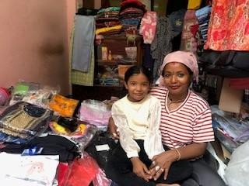
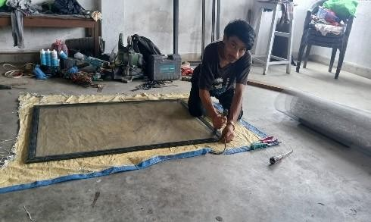
INRL Project’ Achievements
Business Recovery Support
  Provided business start-up and recovery support to 49 households (21 PWDs, 40 MVFs) impacted by economic challenges, including COVID-19.
  Support items included grocery supplies, textiles, machinery, and household construction materials.
  Restoration of business operations leading to increased household income by NRs. 3,000–5,000, improved financial stability enabling better access to food, education, and healthcare, enhanced confidence and motivation to expand livelihood activities, and creation of additional income sources through diversified business opportunities.

Slide 15
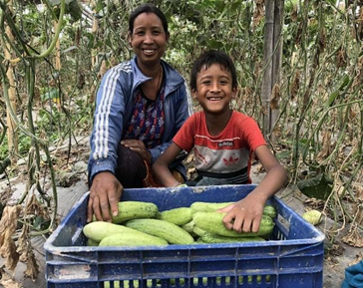
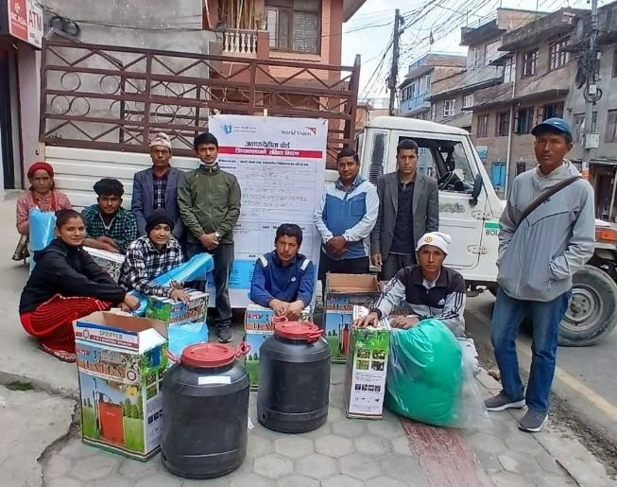
INRL Project’ Achievements
Smart Subsidy Support
  Introduced GESI-sensitive smart subsidies to enhance agricultural productivity and reduce women’s labor burden.
  Benefited 253 farmers (1 PWD, 84 MVFs) through GESI-sensitive agricultural subsidies.
  Inputs provided via a cash voucher system, including seeds, agricultural machinery, irrigation pipes, plastics, and bamboo, selected based on PG member needs.
  Farmers experienced significant improvements in both agriculture and livelihood. Timely access to better quality seeds, agricultural machinery, irrigation pipes, plastics, and bamboo enabled them to cultivate more efficiently and increase crop yields. The provision of GESI-sensitive subsidies reduced women’s labor burden, allowing them to focus on other income-generating activities and household responsibilities. Inclusion of marginalized groups, including Persons with Disabilities (PWD) and Migrant-Returned Female (MVF) farmers, ensured equal opportunities to improve farming practices. With improved irrigation facilities, high-quality inputs, and modern tools, farmers achieved better productivity, year-round production, and increased household income, strengthening food security and paving the way for sustainable livelihoods.

Slide 16
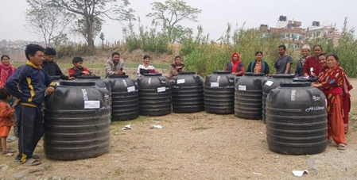
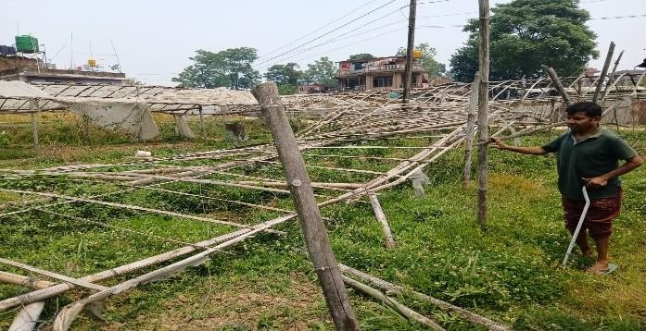
INRL Project’ Achievements
Flood Recovery Support
  On Asoj 12, 2081, a flood devastated agricultural land, tunnels, livestock, and crops in Kirtipur Municipality, affecting 147 households.
  Emergency support included materials such as plastic tunnels and bamboo to help rebuild farm structures and restore livelihoods.
  Affected farmers were able to quickly rebuild damaged agricultural land, tunnels, and livestock shelters using materials like plastic tunnels and bamboo. This emergency aid helped restore farm structures and revive crop production, enabling 147 households in Kirtipur municipality to recover their livelihoods and improve food security after the devastating flood.

Slide 17
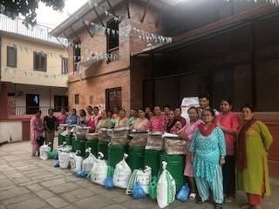
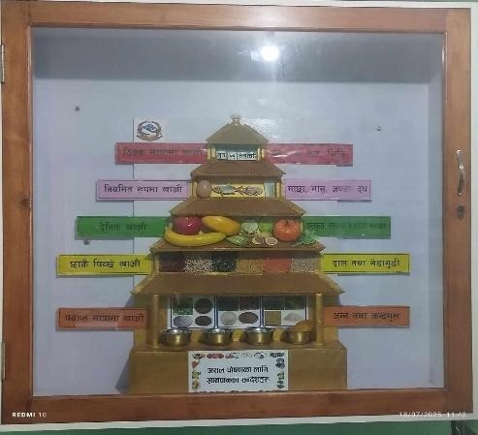
INRL Project’ Achievements
Material Support to Local Level
  Provided 17 types of disaster management equipment including ladders, gloves, boots, helmets, hammers, and microphones to community and local disaster management committees across Kirtipur and KTM-16.
  Supported Bhajangal Urban Health Center (Kirtipur Ward 7) with essential health equipment such as a nutrition corner setup and weighing machines, improving local health service capacity.
  Supplied kitchen gardening materials including cocopeat, seeds, compost, and beans to Kirtipur Municipality wards 1, 2, 7, 8, and 10 to promote household-level food production and nutrition.
  This support fostered stronger public-private partnerships (PPP) and enhanced the community’s resilience and well-being through improved disaster response, health services, and food security.

Slide 18
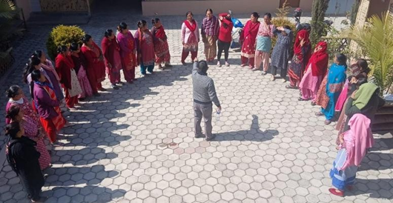
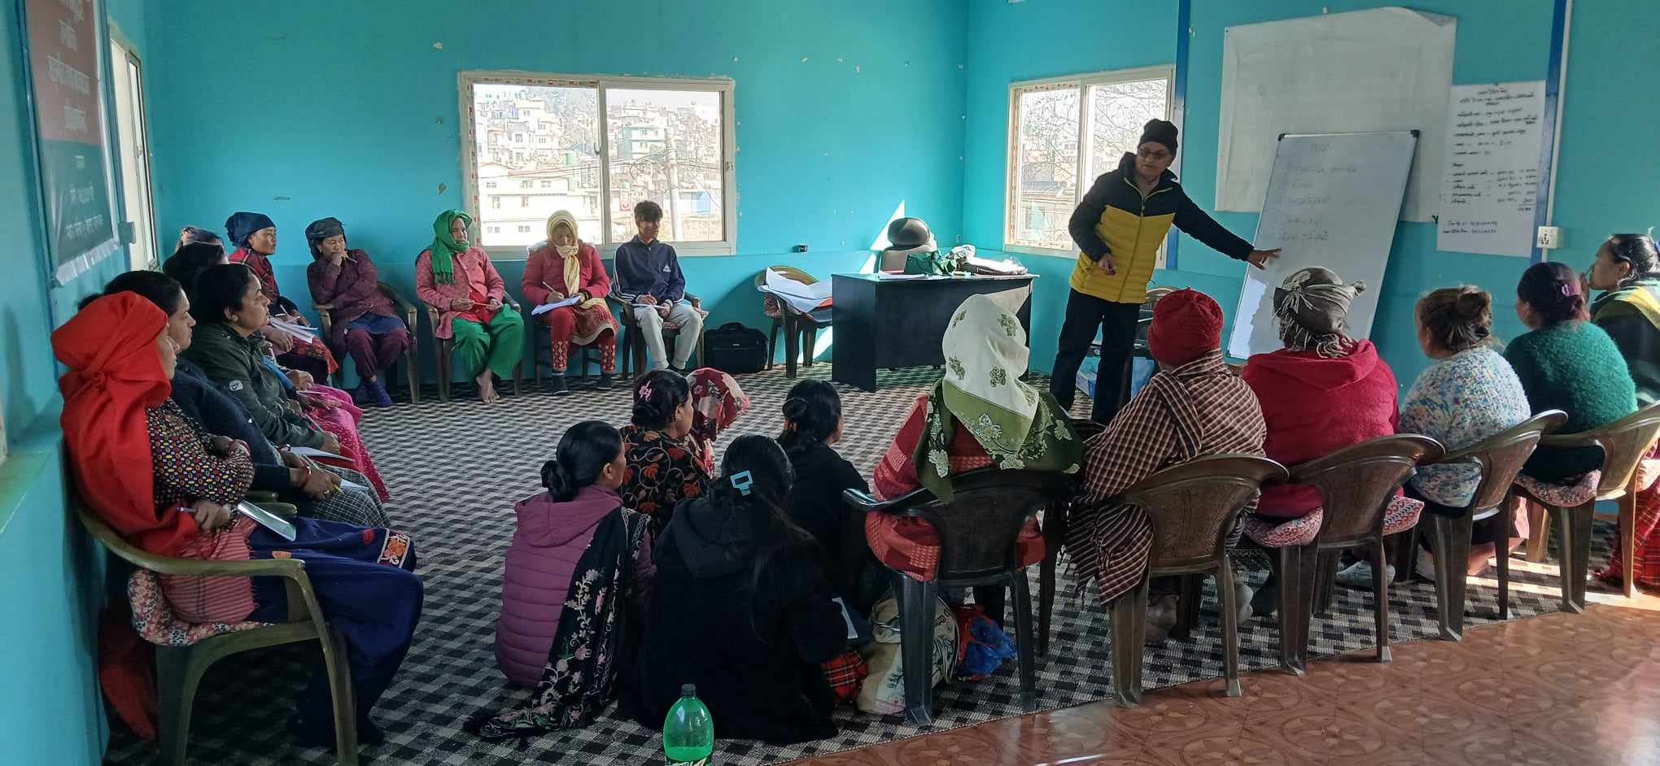
INRL Project’ Achievements
Training and Capacity Building (EWV) Training)
  Trained 1,218 beneficiaries (26 PWDs, 473 MVFs)by Empowered World View training to promote sustainable livelihood and nutrition through mindset transformation.
  It encouraged the development of positive habits like regular saving and helped challenge harmful social taboos, such as those around menstruation. By shifting these deep-rooted beliefs, the training empowered participants to adopt sustainable livelihood practices and improve their overall nutrition and well-being.

Slide 19
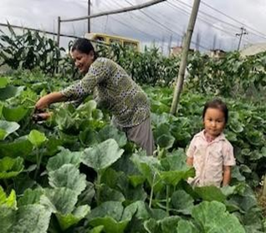
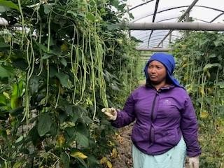
INRL Project’ Achievements
Agricultural Input Support & Soil Test Campaign
  933 farmers trained (26 PWDs, 473 MVFs) on sustainable farming practices such as biological pest control, production planning, clubroot management, and off-season tomato cultivation.
  First-ever soil testing campaign in Kirtipur Municipality, conducted in partnership with the Central Agricultural Laboratory, DoA, MoALD.
  201 soil samples were tested, with recommendations leading to the adoption of agricultural lime use for soil health improvement.

Slide 20
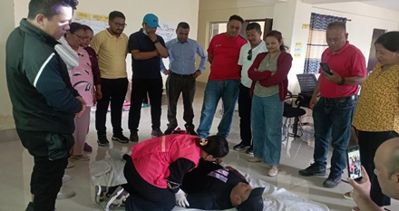
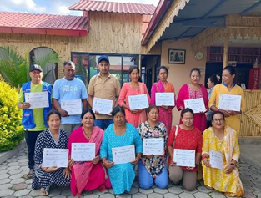
INRL Project’ Achievements
Disaster Risk Reduction (DRR) and Community First Responder (CFR) Training
DRR training delivered to 7 CDMC/LDMCs, covering common disaster risks and mitigation strategies.
Community First Responder Training had conducted to 67 Community Disaster Management Committee members for emergency responds and Disaster Preparedness.
They were also awarded certificates recognizing their newly acquired skills.

Slide 21
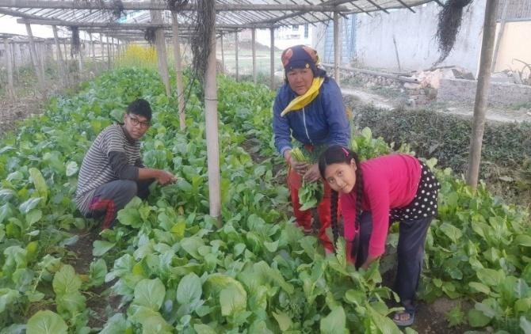
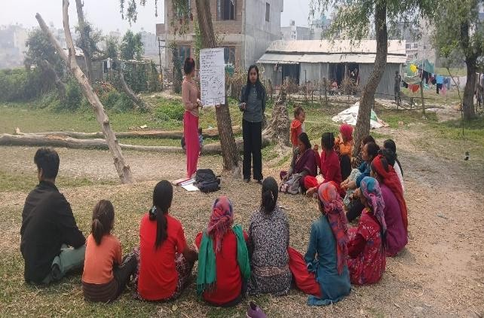
INRL Project’ Achievements
Climate-Smart Agriculture (CSA) Training
665 farmers (5 PWDs, 350 MVFs) trained on climate-resilient agricultural techniques to address climate change impacts.
Developed better understanding of climate change and its impacts on agriculture, women, and children, learning about activities that contribute to climate change and greenhouse gas (GHG) emissions from agriculture. They also learned practical ways to reduce these emissions through sustainable farming practices. As a result, more than 50% of the farmers adopted climate-smart agriculture techniques in their fields, including the use of traps and lures for pest control and natural inputs like jholmal, Trichoderma, Pseudomonas, Bacillus, animal urine, dung, and plant-based pesticides, thereby enhancing their resilience against climate change impacts.

Slide 22
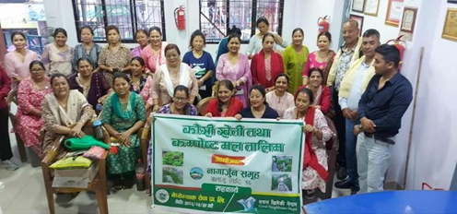
INRL Project’ Achievements
Kitchen Gardening Training
  130 members from wards provided with the rooftop farming and kitchen gardening training.
  85% of participants have successfully established their rooftop garden and kitchen garden.
  Reduced dependency on markets for vegetables, allowing them to consume fresh, chemical-free produce directly from their gardens. Kitchen waste was turned into manure for composting, promoting cleaner environments. Children learned cultivation skills from their parents, fostering the habit of growing their own food.

Slide 23
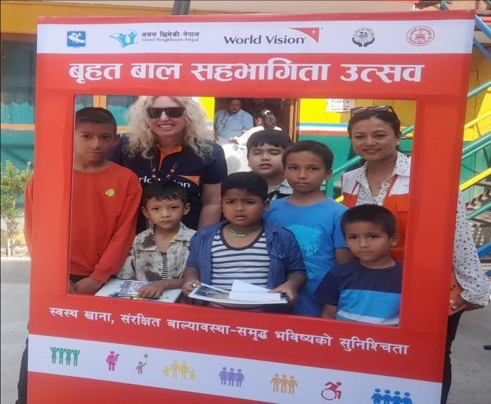
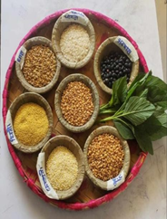
INRL Project’ Achievements
Mass Awareness Activities
Total participants: 5,259 children and parents (13 children with disability, 6 parents with disability, 1,435 MVFs, and 2,371 vulnerable children).
This event aims to raise awareness about healthy eating habits and the harmful effects of junk food. Through school orientations, dramas, and storytelling, participants learned about the cultural importance of traditional foods and how incorporating these into daily diets can promote better nutrition, preserve cultural heritage, and support local food systems.

Slide 24
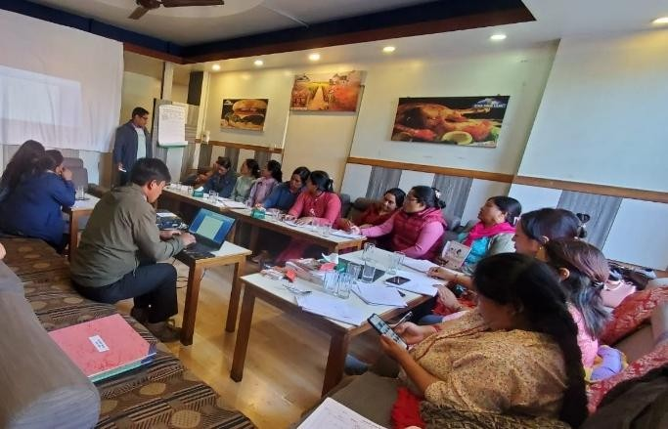
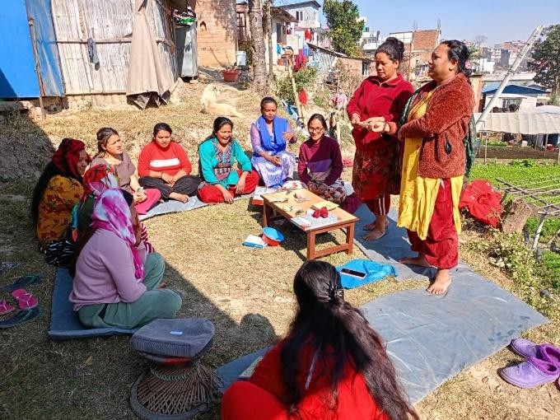
INRL Project’ Achievements
Linkage with Financial Institutions :
Total 704 members were linked with bank and cooperatives.
Total saving fund: 82,00,000
Total investment fund: 59,00,000
Total share: 9,22,000
S4N Groups:
Total 30 S4N Groups both in Kirtipur and Balaju. Out of which 5 groups have shared out and 26 groups are continuing.
Total saving fund is 32,52,740 and total investment fund is 25,29,630.
429 saving 4 nutrition members were engaged.

Slide 25
INRL Project’ Achievements
Linkage with Financial Institutions :
Total 704 members were linked with bank and cooperatives.
Total saving fund: 82,00,000
Total investment fund: 59,00,000
Total share: 9,22,000
S4N Groups:
Total 30 S4N Groups both in Kirtipur and Balaju. Out of which 5 groups have shared out and 26 groups are continuing.
Total saving fund is 32,52,740 and total investment fund is 25,29,630.
429 saving 4 nutrition members were engaged.

Slide 26
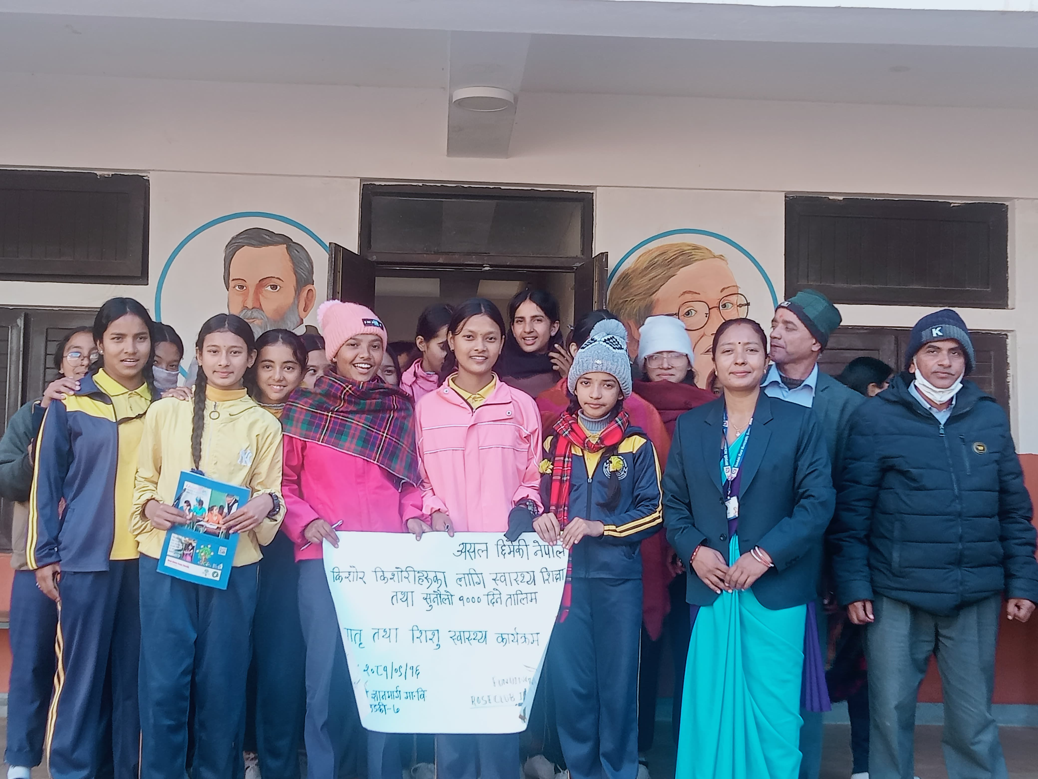
Maternal Child Health Project
Type of Project : Health Education
Area of Focus: Safe motherhood and Child.
Funding Partner: Rose Club International -Korea
Project Period: February 2025 to January 2026).
Project Location: Gandaki Rural Municipality, Gorkha, Gandaki Province.
Main Objective: Safe motherhood and child nourishment
Warm clothes distribution to mothers with children
Target Beneficiaries: Pregnant and Lactating Women with children and adolescences as well as FCHVs.
Total Human Resources: 1 (Part-time)

Slide 27
MCH Project- Major Achievements
Project Approval by SWC.
Inception Workshop has conducted in Gandaki Rural Municipality.
Provided the warm clothes and blanket to pregnant women and lactating women (60 women.
60 Pregnant women and Lactating women with children have received nutrition foods (Beaten rice, Grams, and nutritious foods) in four times (240HHs).
60 Trained to Pregnant women and Lactating women with children about Health Education.
Health Education provided to adolescences in school level of Gandaki RM.
Monitoring and Evaluation with PHC Staffs and DPAC meeting has completed in Gandaki RM.
Progress Report submission to Rose Club International in monthly basis.

Slide 28
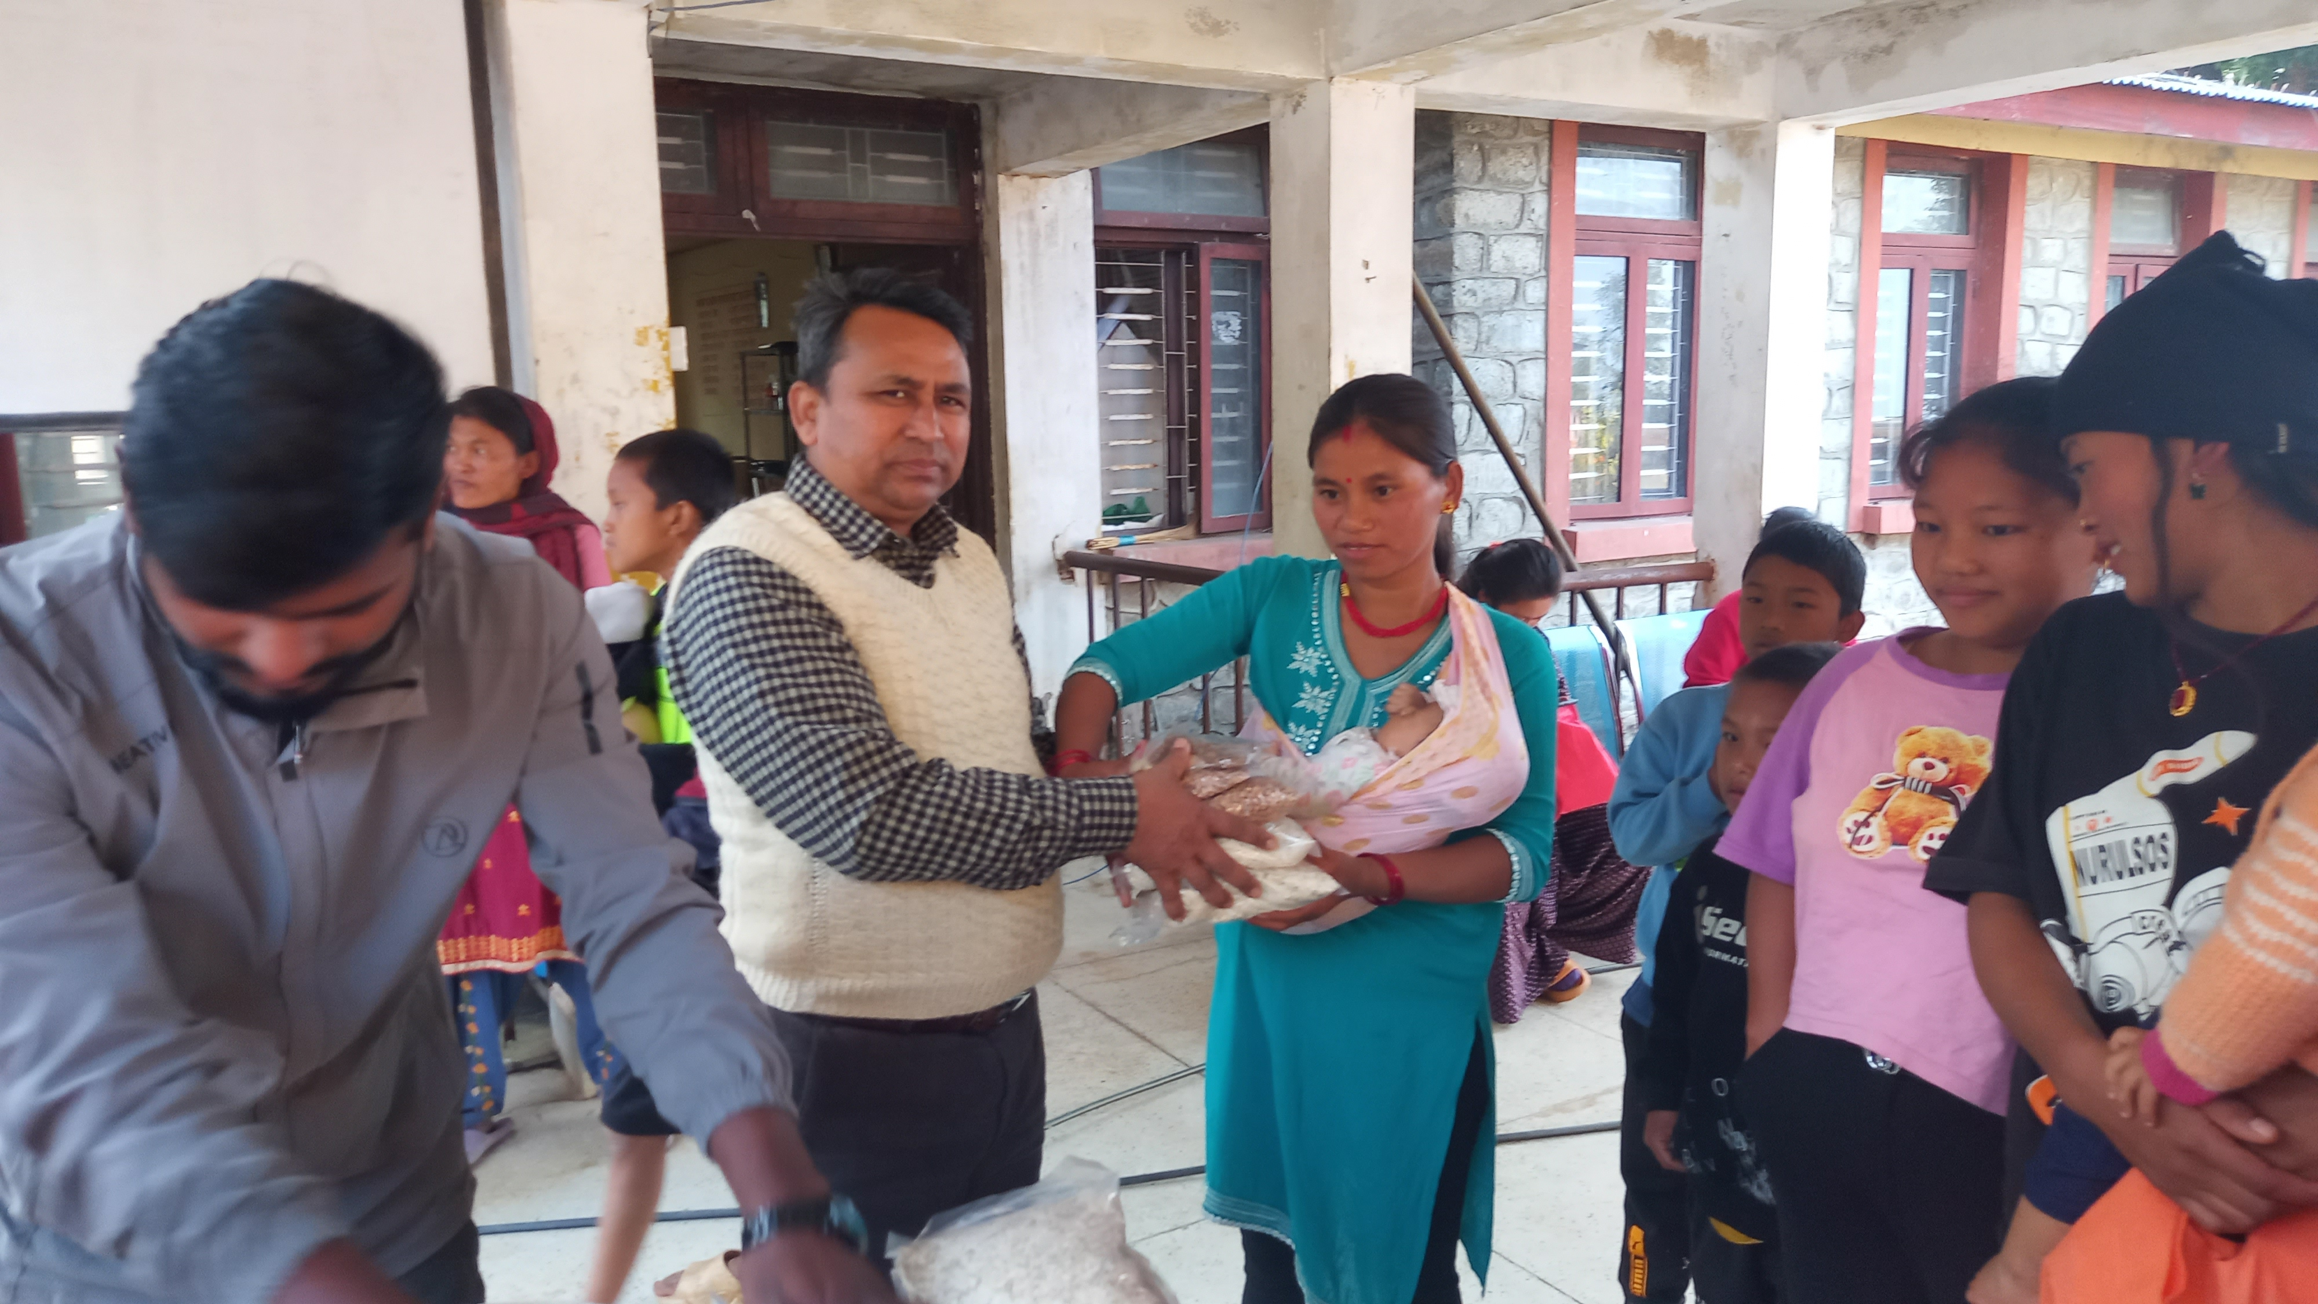
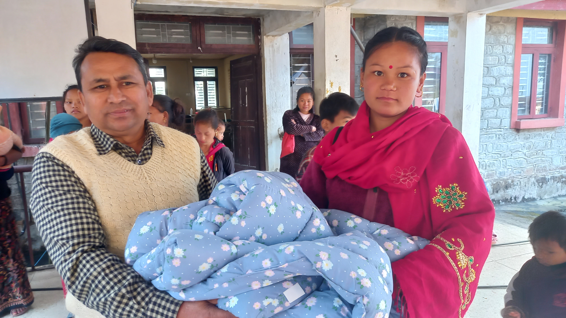
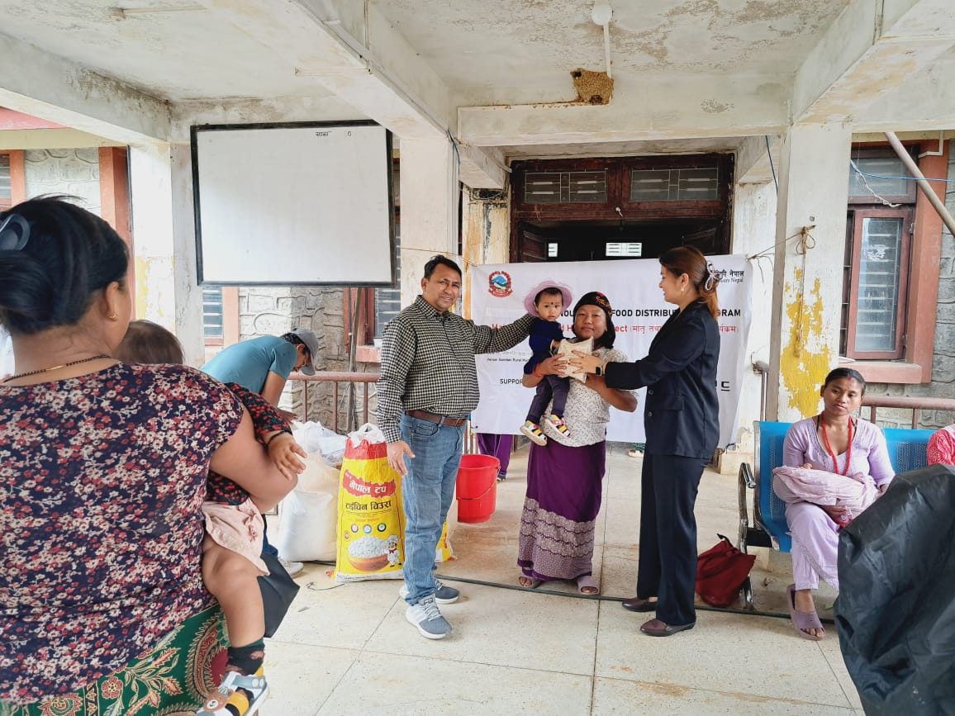
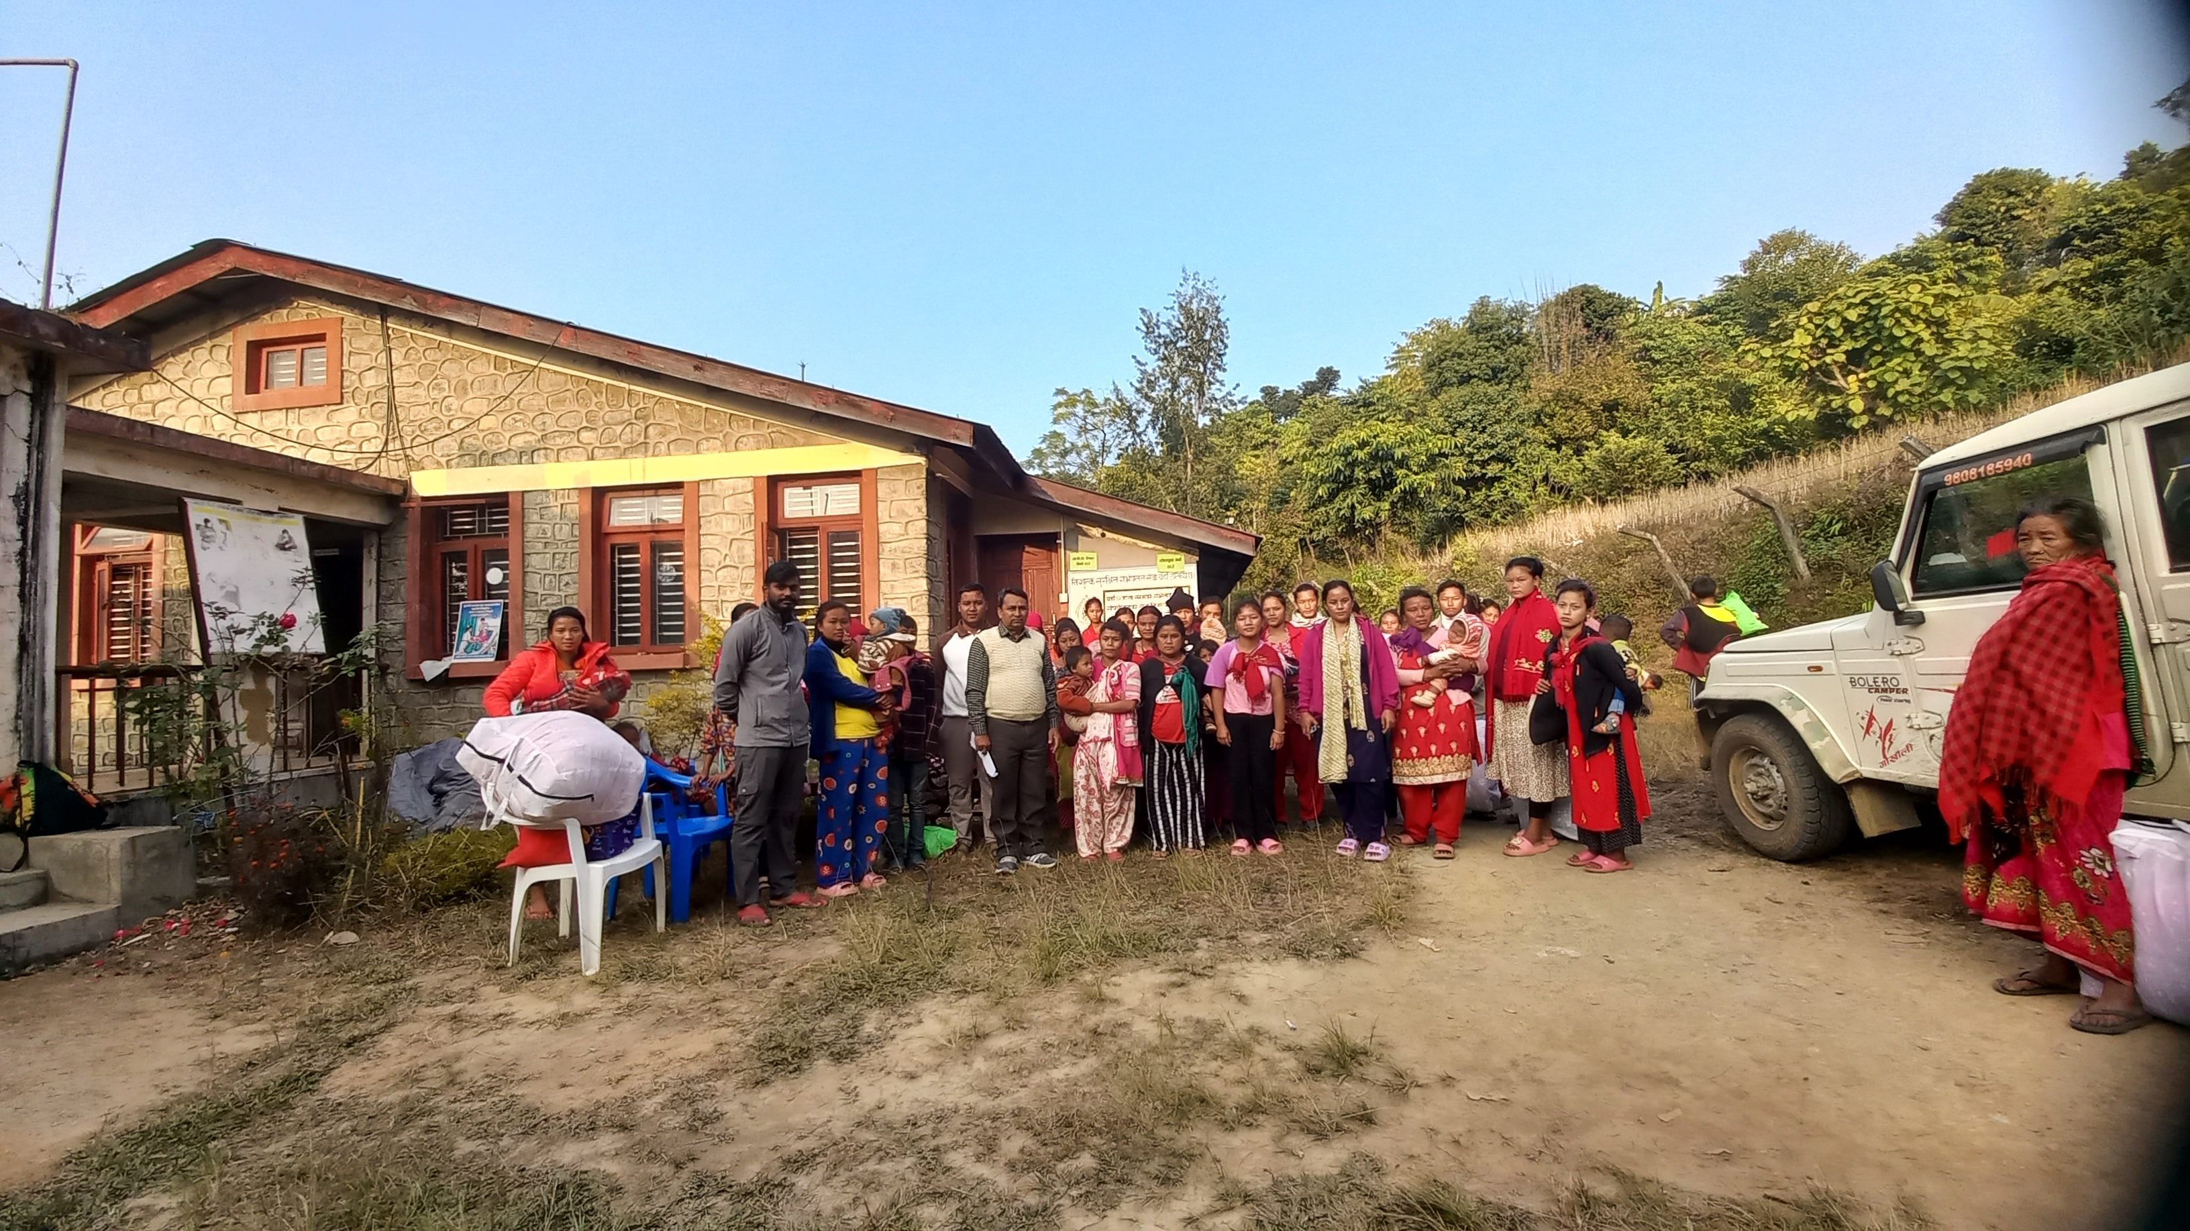
Provided Nutrition Foods to Mothers with Children
Provided warm clothes to mothers and pregnant women

Slide 29
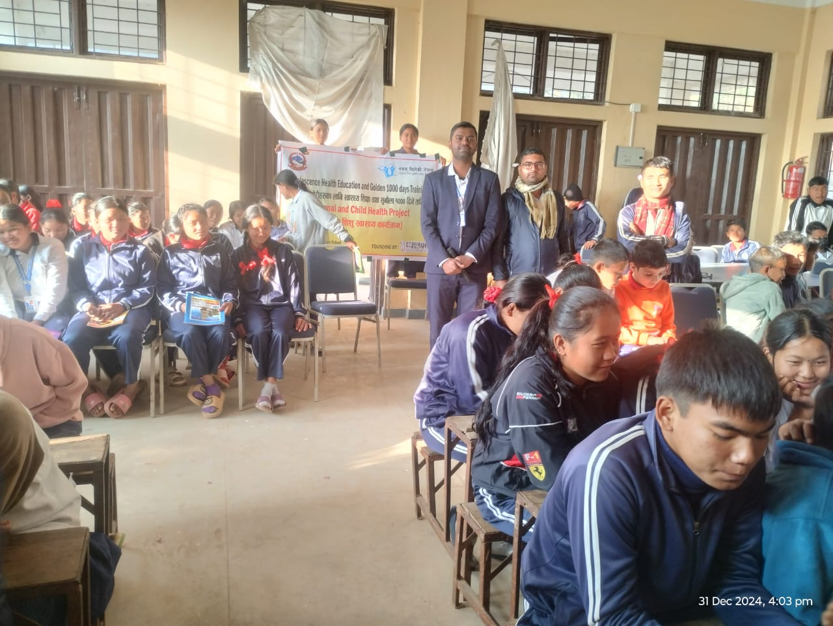
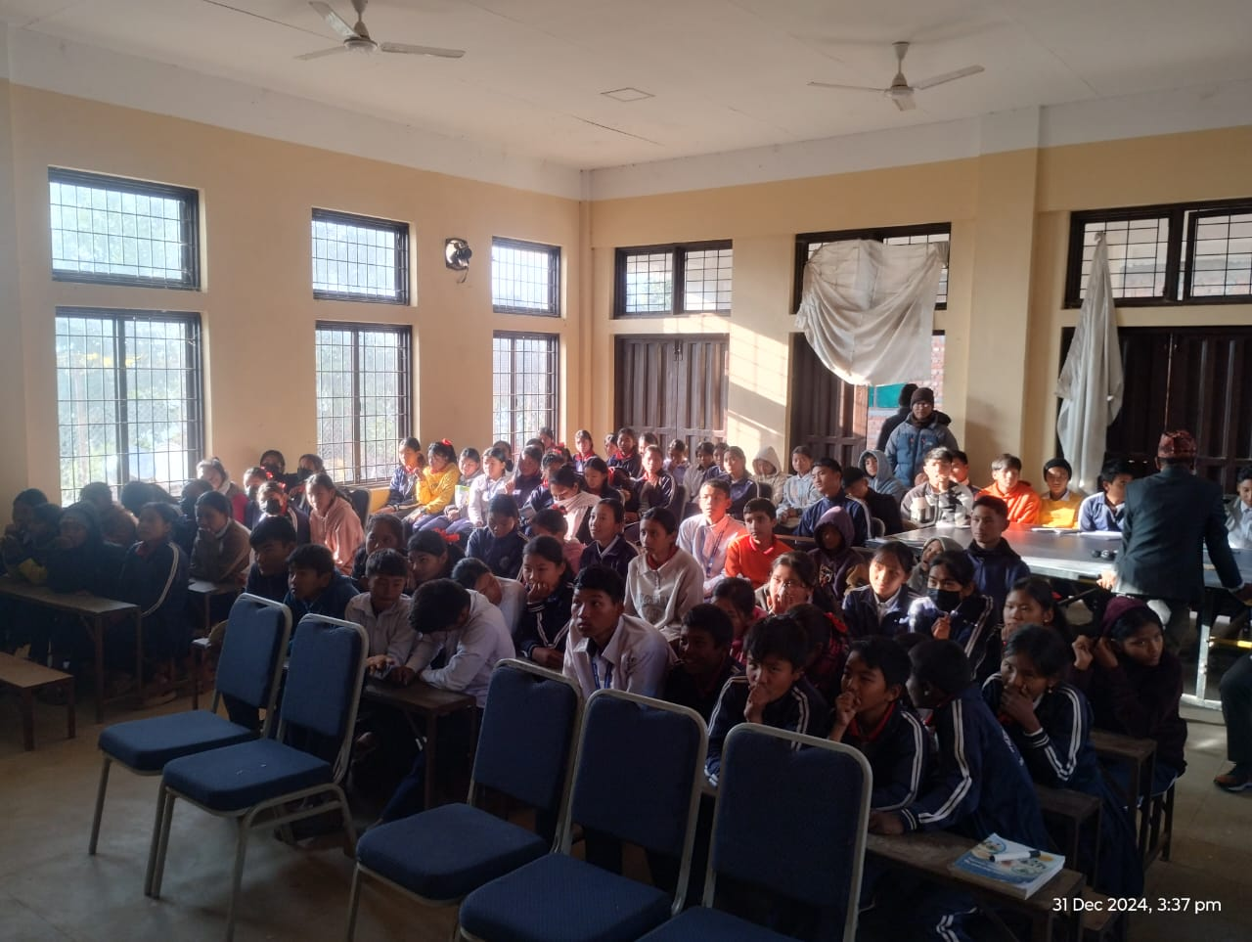
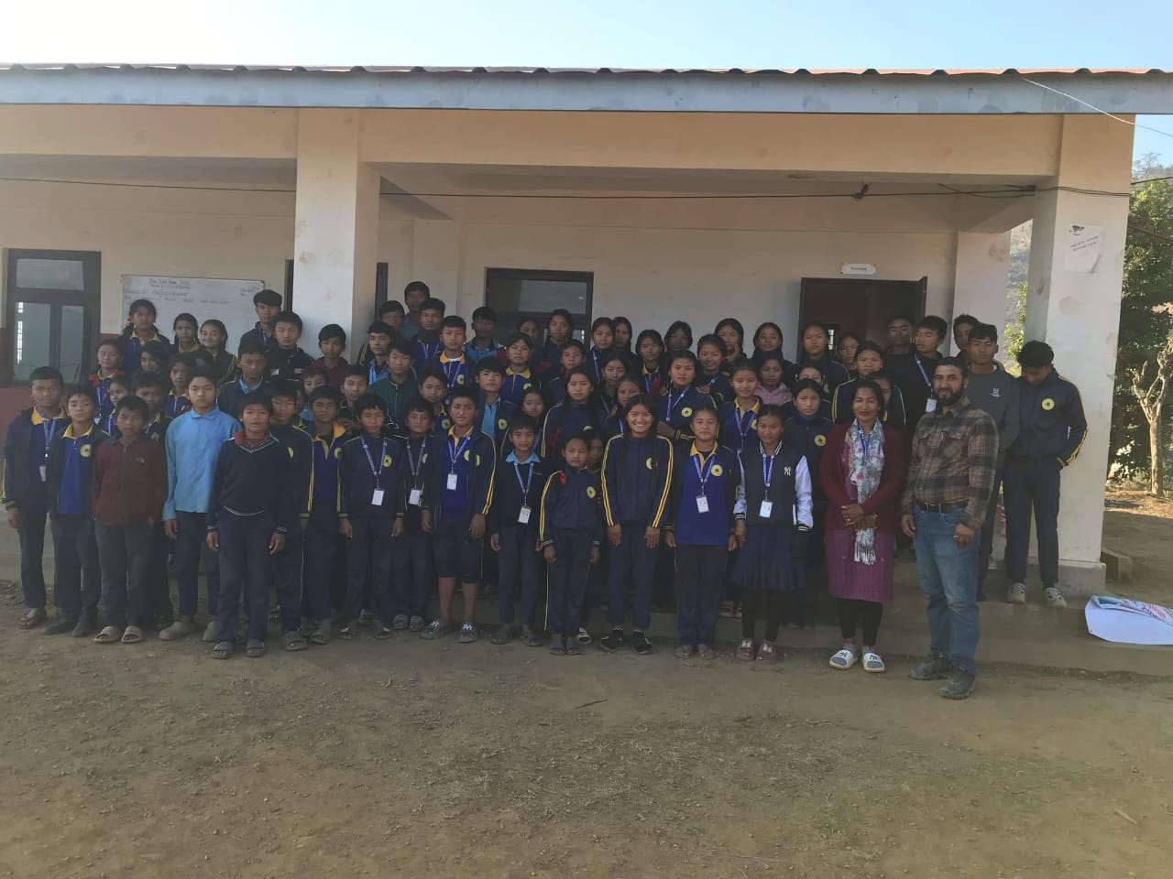
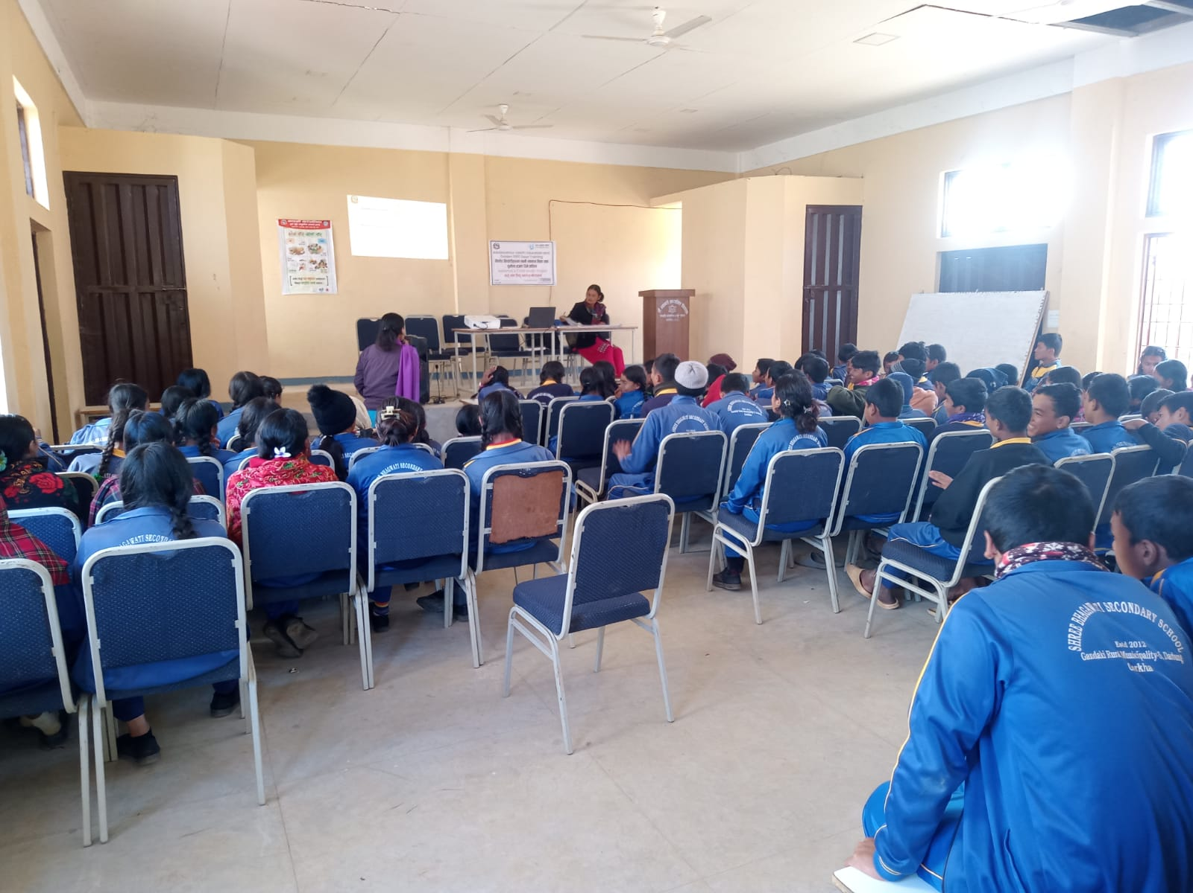
Provided Health Education Training to 1000 adolescences

Slide 30
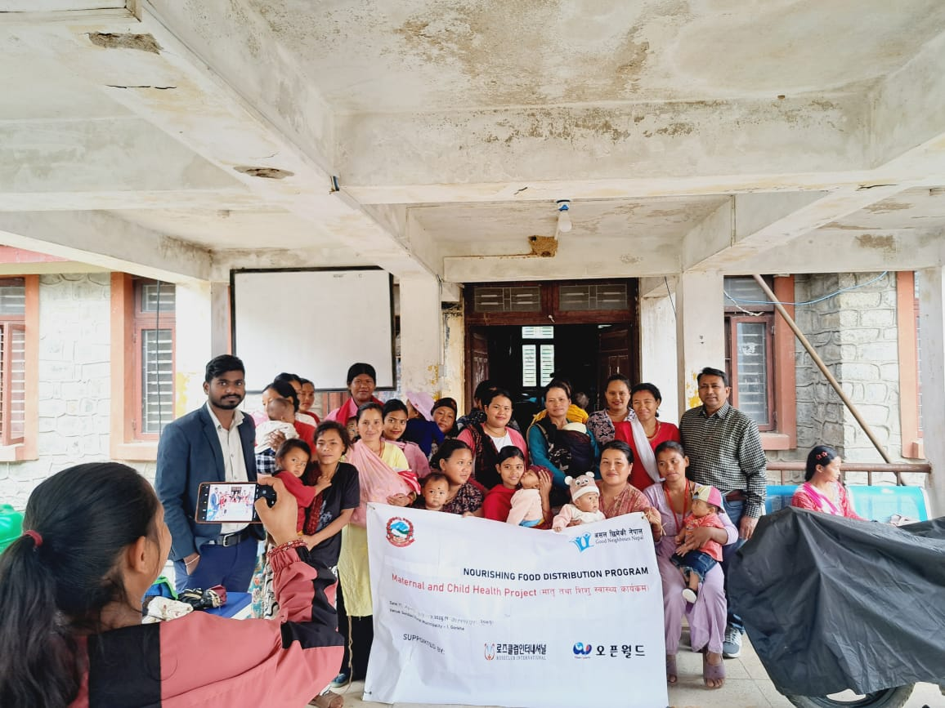
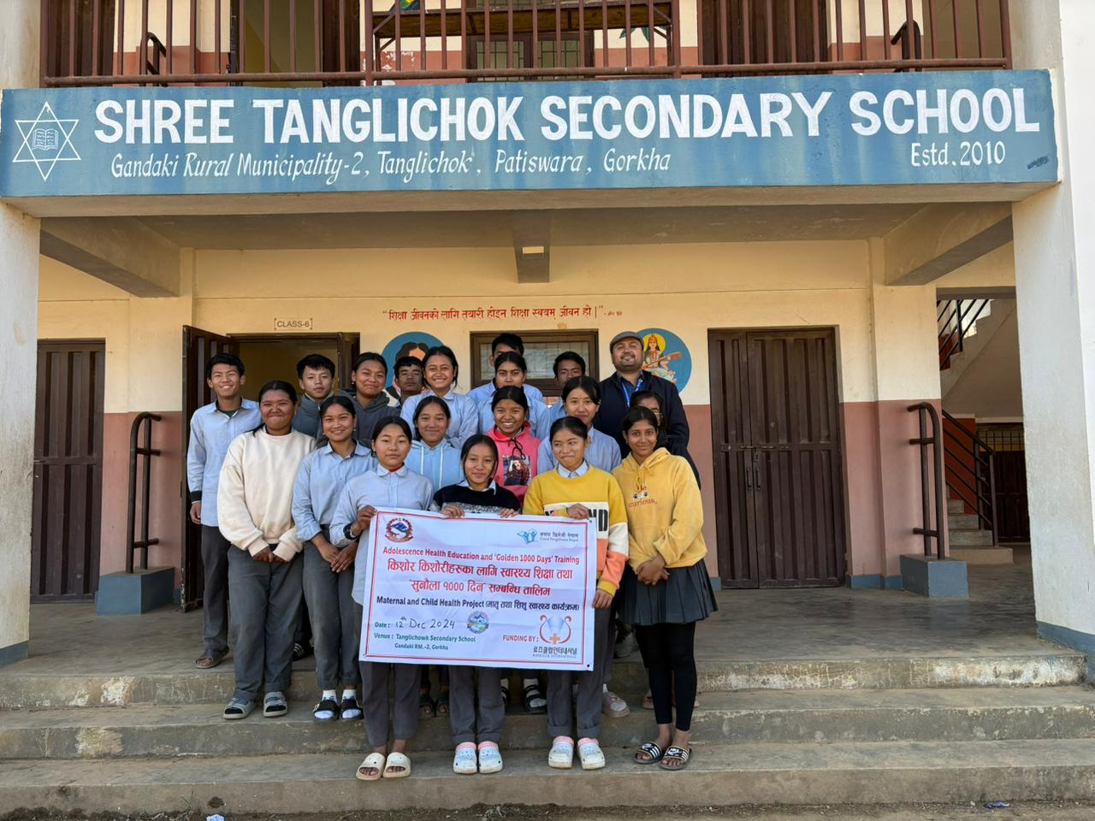
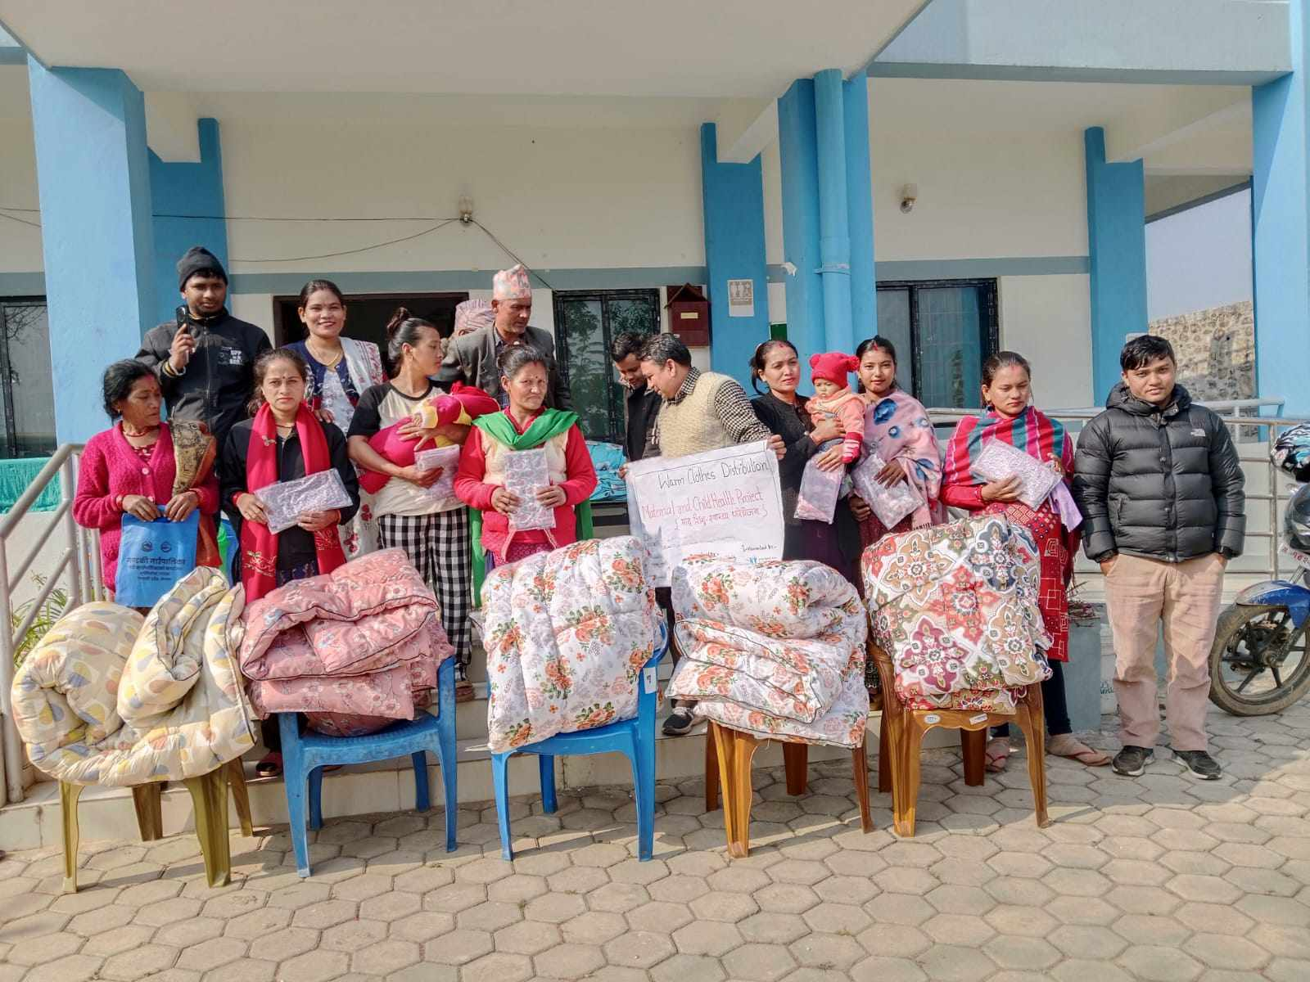
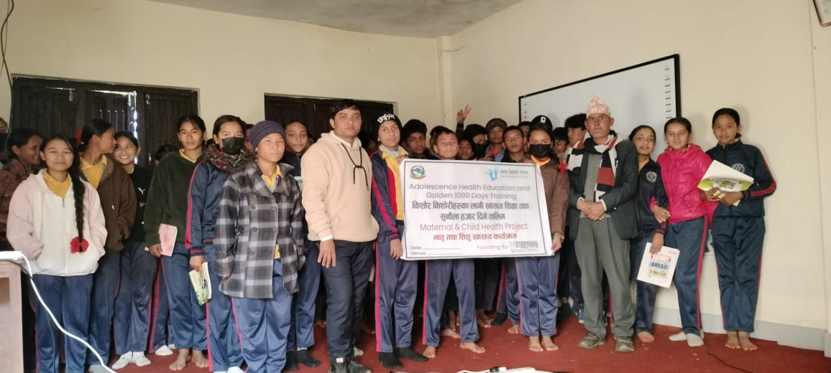
Provided Warm Clothes
Provided Nutrition Foods
Provided Health Education Training

Slide 31
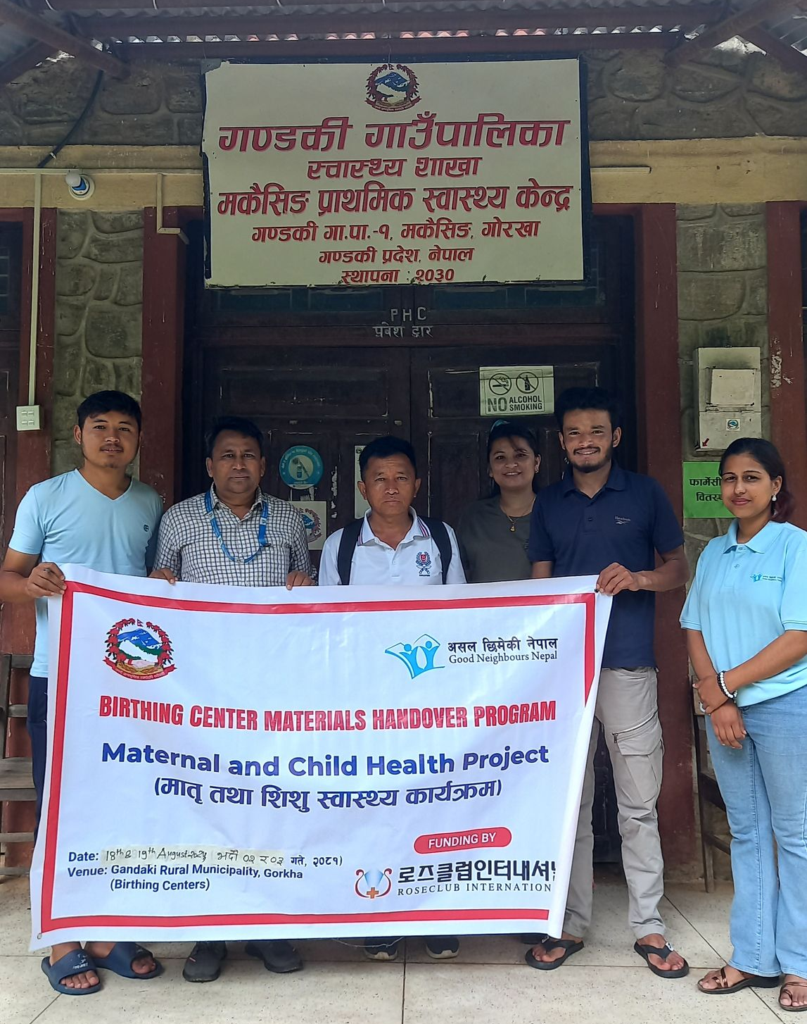
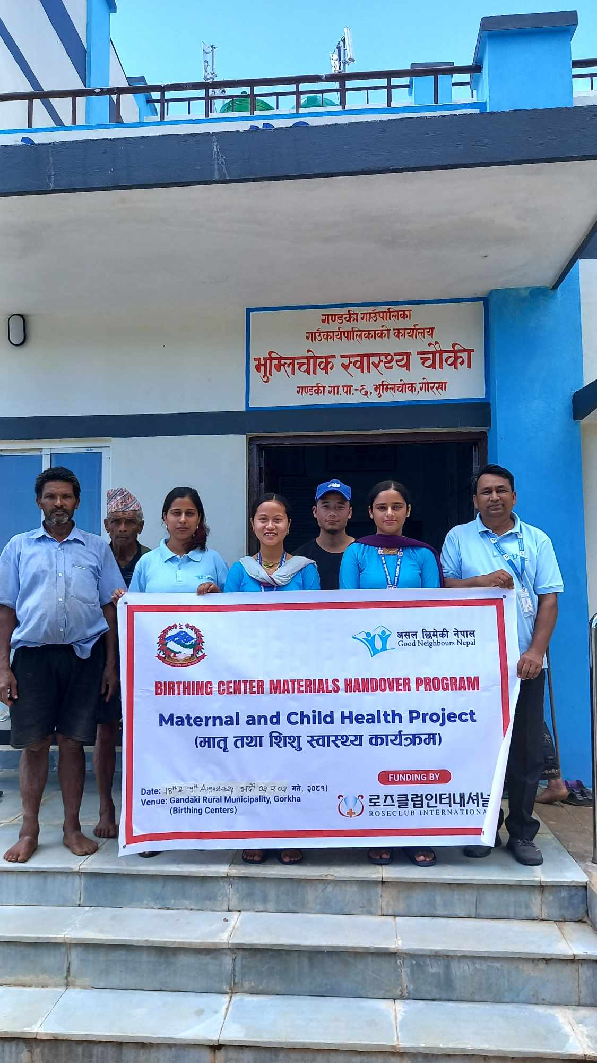
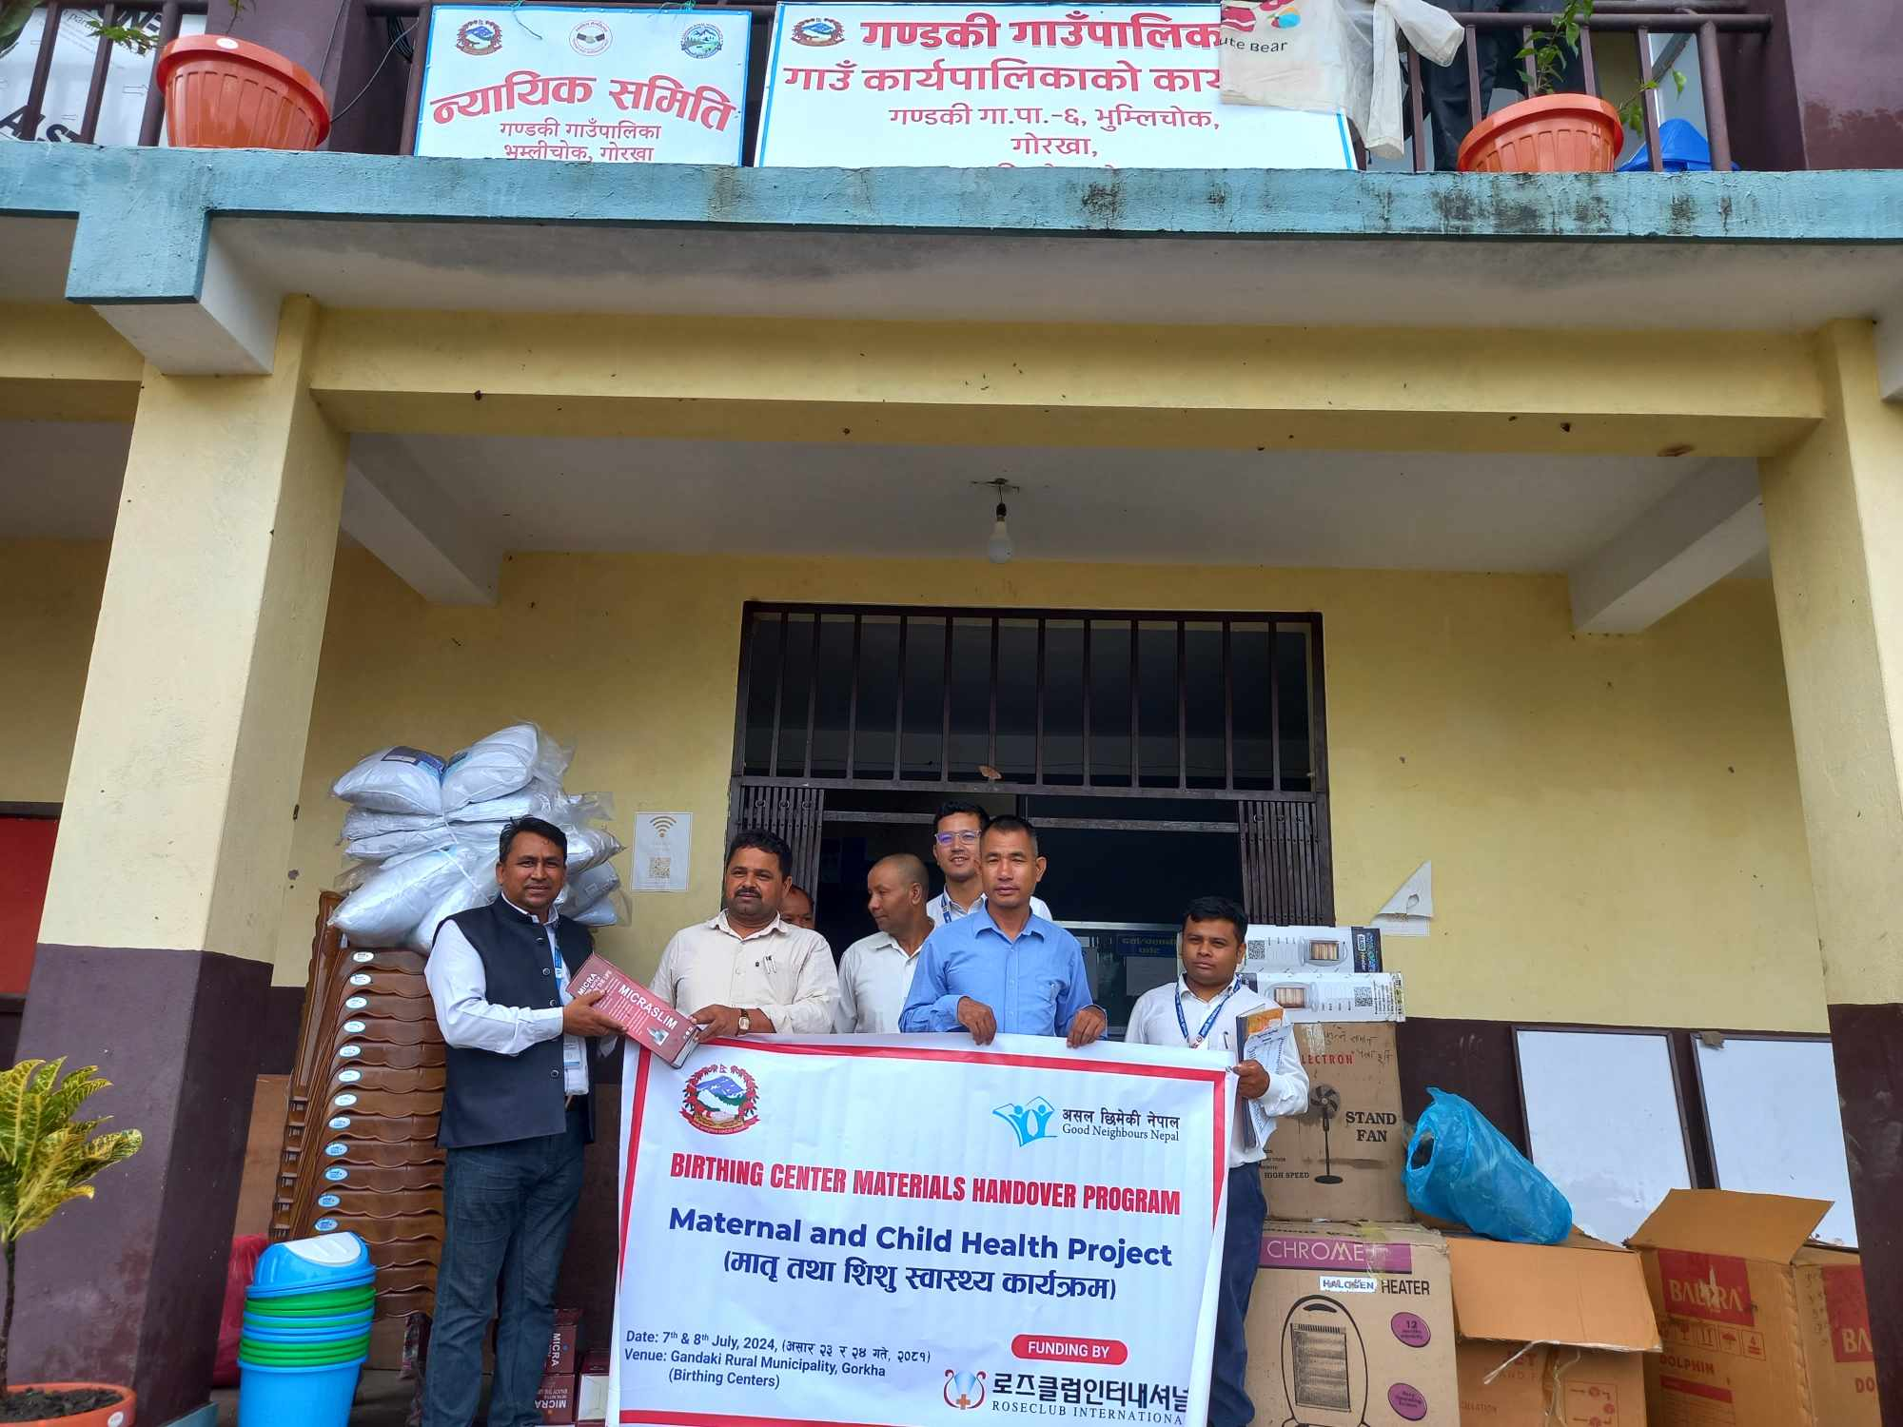
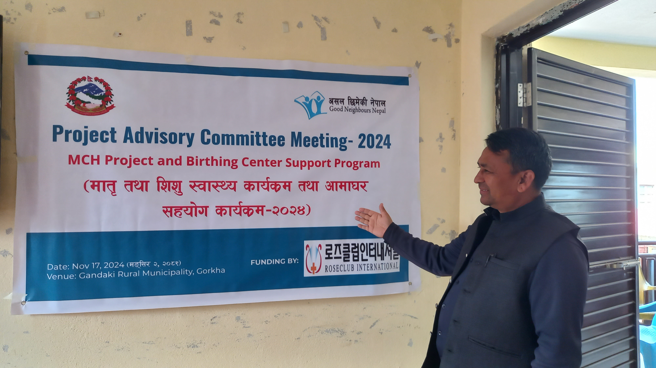
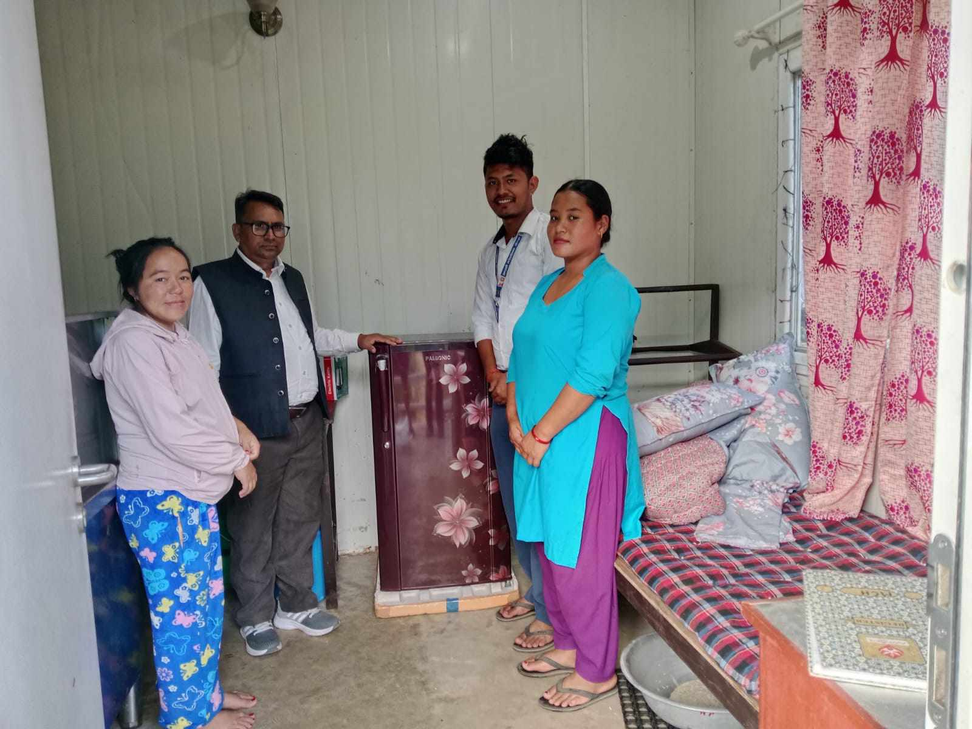
Provided Birthing Center Equiment
Attended MPAC Meeting at Gandaki RM

Slide 32
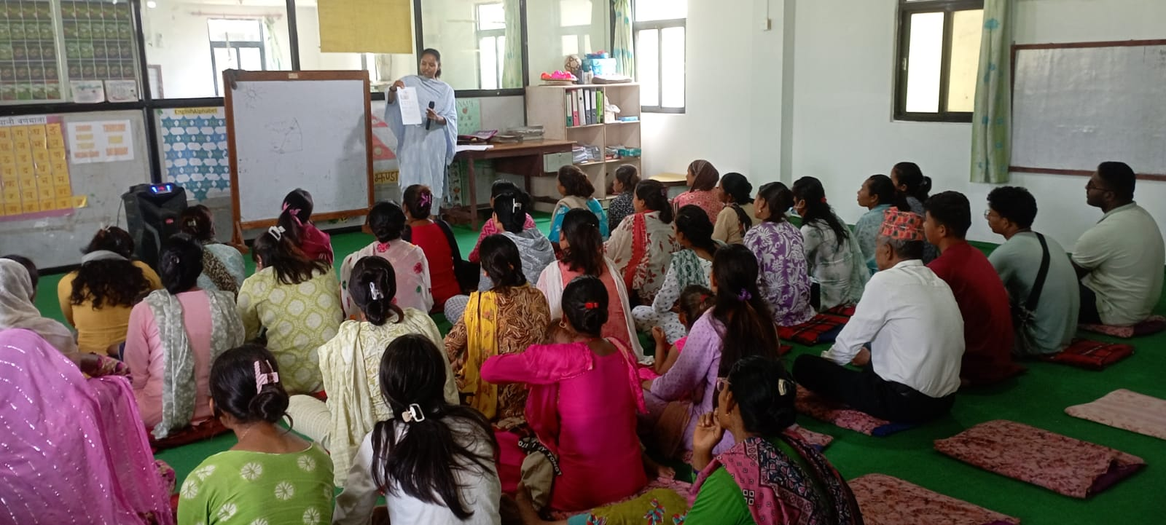
Early Child Development Project-Kailali
Type of Project : Early Child Development-Kailali
Area of Focus: Early Child Education
Funding Partner: China Basket Fund
Project Period: April 2023 to March 27
Project Location: Janaki Rural Municipality, Kailali, Sudurpaschim Province.
Main Objective: Early Child Development with Quality Education.
Good Parenting Education.
Engaging- livelihood for continue educational support
Target Beneficiaries: 45 Children with parents
Total Human Resources: 6

Slide 33
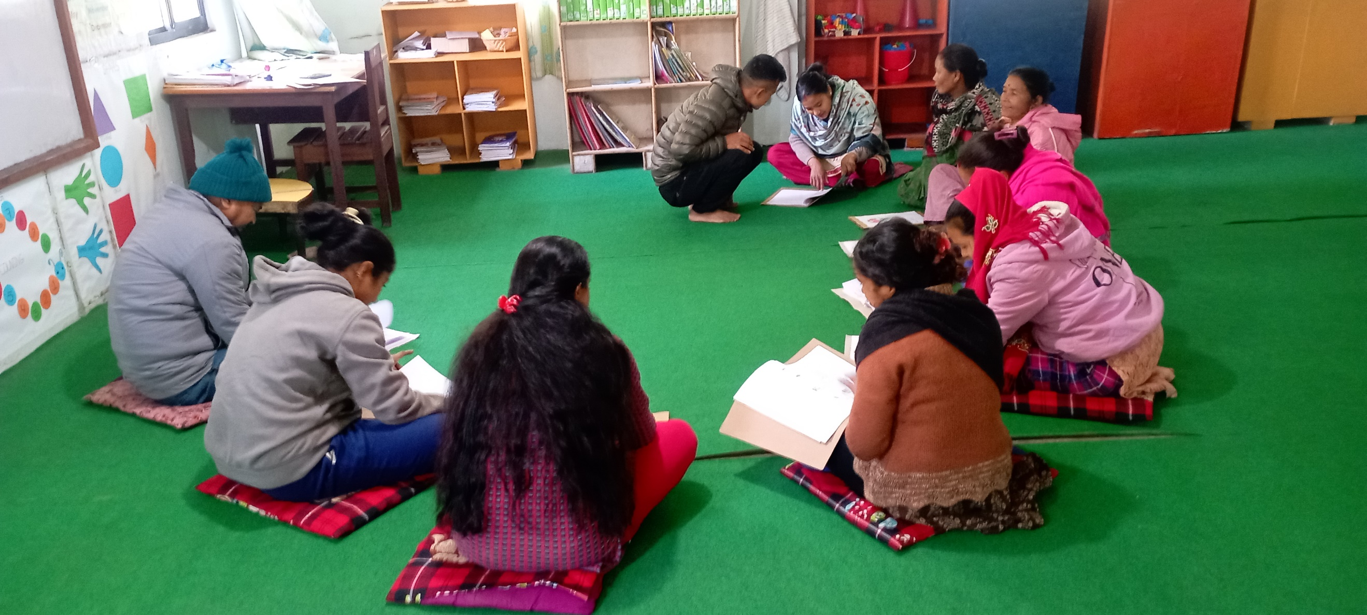
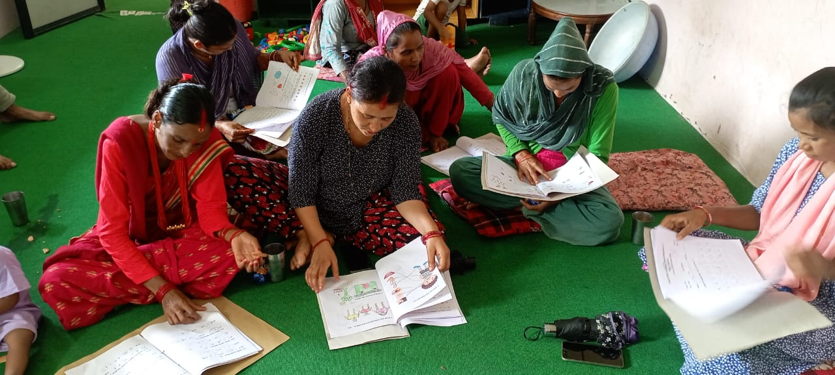
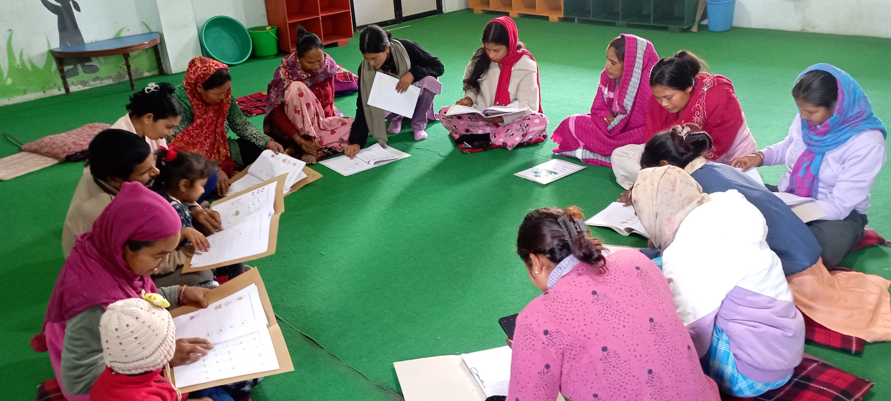
ECD Project-Kailali Achievements
Early Child Development –Kailali Mom Center is running funded by China Basket Fund.
The ECD is focused to children of poor and marginalized and Tharu tribes’ families.
Its main goal is provided quality education and take care of children with well hygiene maintain.
Orientation to parents how to take care of them and set good environment for children.
63 children are learning from ECD-Kailali Mom center with well-equipped environment.
6 human resources (1 Program Manager, 3 Teachers,2care takers) are engaged in operating ECD-Kailali mom center.

Slide 34
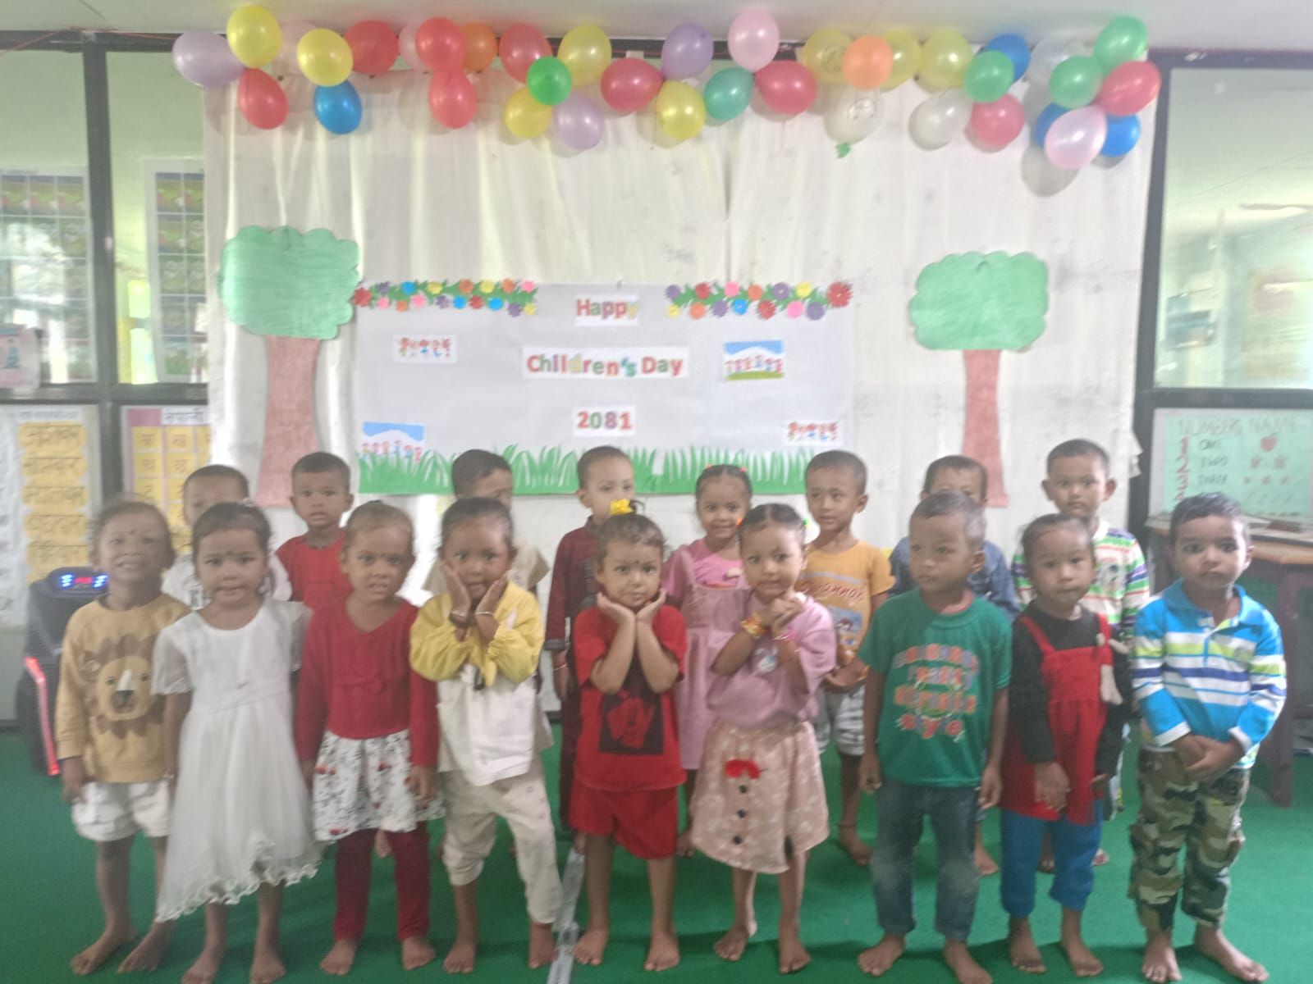
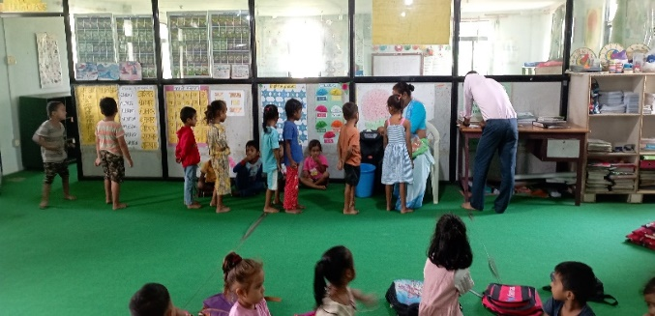
ECD Project-Kailali Achievements
Provided quality education with well take care of children those community people are poor in Janaki Rural Municipality of Kailali District.
Build excellent school in this area.
Making strong relationship and serving to the community.
12 children are graduated by this year.
Vitamin A giving

Slide 35
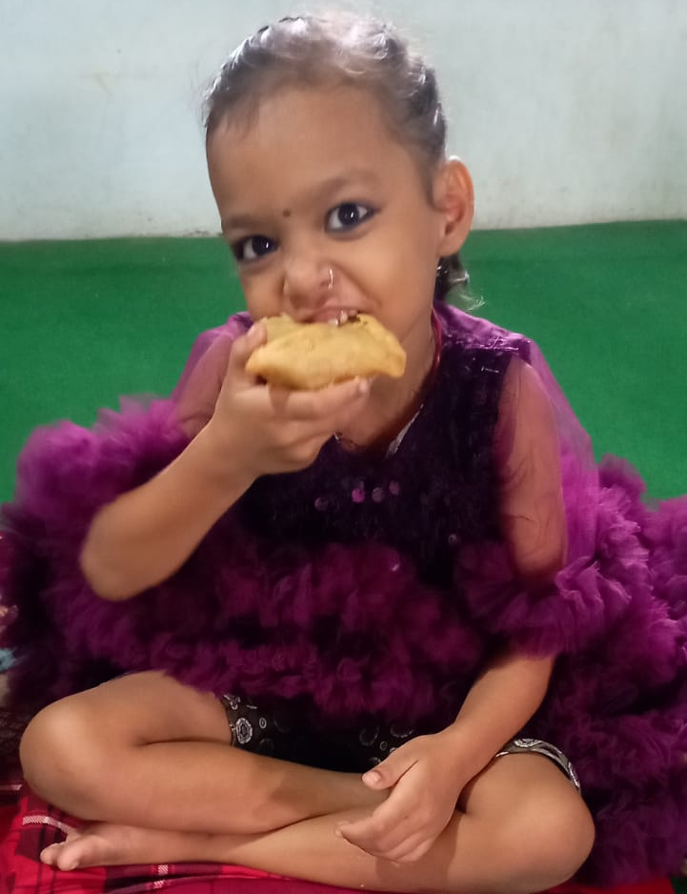
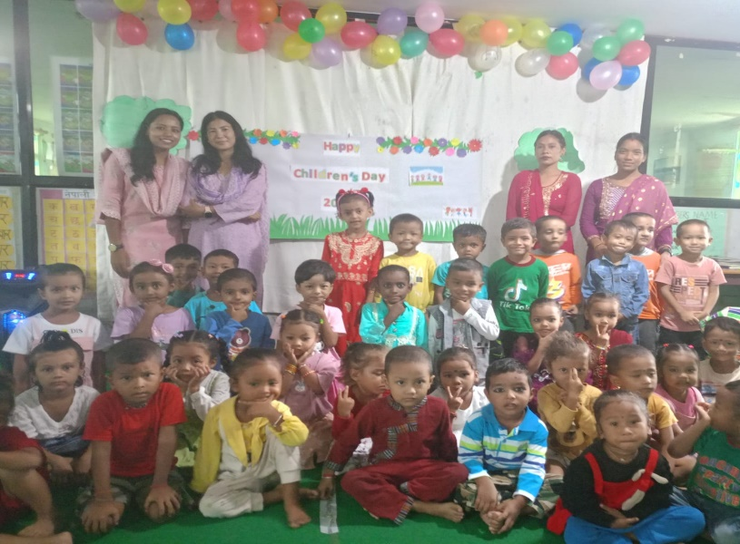
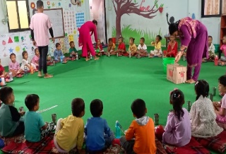
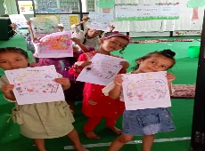
ECD Project-Kailali Achievements
Painting has completed in building.
Sponsors have visited Mom center.
Co-relation with parents and the community.
Teacher’s training has been given by Gennie & Team.
CPR orientated to teachers.
Renovation of Mom center’s bathroom and toilet.
Installed two air-conditioners and guestroom have been made.

Slide 36
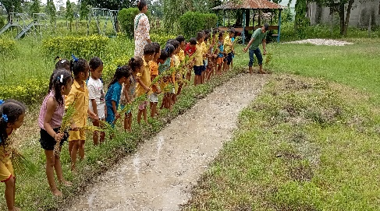



ECD Project-Kailali Achievements
Conducted teacher’s training
Conducted Children’s program
Conducted orientation program
Conducted Parent’s meeting
Conducted paddy plantation activity
Organized Field visit program
Extra English teaching activity for enhancing children progress
Paddy Plantation Activity

Slide 37



ECD Project-Kailali Achievements
12 children were graduated in the last Education FY 2081.

Slide 38







ECD Project-Kailali Achievements
Children involved in extra activities.
Children are playing in school ground

Slide 39




ECD Project-Kailali Achievements
Provided nutritious foods to children in school day.
Provided the health and sanitation orientation to children with parents for healthy environments.

Slide 40


ECD Project-Kailali Achievements
Conducted Teachers Training facilitated by Chinese team/Australian –Genne

Slide 41









ECD Project-Kailali Achievements
Dashain and Tihar card distribution program
Decorated rooms for guests

Slide 42






ECD Project-Kailali Achievements
Conducted frequently Exam as per required

Slide 43


Badikhel Library Project-Lalitpur
Library Project: Library project is running in Badikhel Godawari Municipality of Lalitpur district. It is funded by Bonache-Korean.19 Students (13 boys and 6 girls) are studying in Badikhel Library Project in Godawari Municipality of Lalitpur district. Good Neighbours Nepal has been coordinating with Godawari Municipality-4 warda chairperson and schoolteachers as well for the quality education.

Slide 44



Badikhel Library Project-Lalitpur
Provided primary education to students.
Provided tuition class those children are willing to study from library with freely available.
Provided parenting education to guardians on how to take care of children as well as keep hygienic with maintain health and safety.
Provided nutritious foods as a day snack for the children’s health.
Conducted monitoring and evaluation jointly with ward level representatives for the betterment of quality education.

Slide 45






Badikhel Library Project-Lalitpur
Attended extra – class in Library
Attended tuition class
Meeting with parents
Learning extra activity
Parnets Meeting
Coordination meeting with ward office of Godawari Municipality

Slide 46




Badikhel Library Project-Lalitpur
Provided nutrition foods.
Children attended music activities and learning.

Slide 47



Community First Health Responder Training – Caritas Nepal
Trained 57 community people by CFHR training course.
Capacity enhanced the DRR/CDMC members on preparedness and emergency response

Slide 48
Major Challenges:
Limit resources and unlimited demand
Funding partners priority out of Bagmati Province

Slide 49
Learning and Best Practices:
Strong Coordination and Collaboration with stakeholders
Matching Fund mobilizations
Team building.

Slide 50







Glimpses:

Slide 51




Glimpses

Slide 52
Thank you !!

